Slide 1
Long-Lived Assets
ACT 205 – Fundamentals of Accounting

Slide 2
Part 1: Financial Accounting
Income Statement
Revenues
Less Expenses
= Net Income
Other Comprehensive Income
Statement of
Changes in Shareholders’
Equity
Common Stock
Retained
Earnings
Statement of
Cash Flows
Week 15
Operating
Investing
Financing
Balance Sheet
Assets = Liabilities + Shareholders’ Equity
Cash Week 5
Accounts Receivable Week 6
Inventory Week 6
Long Lived Assets Week 13
Liabilities Week 14
Equity Week 14
The Accounting Process – Weeks 1,2,3,4

Slide 3
Part 2: Managerial Accounting
Terms
Chapter 10
Cost-Volume-Profit Analysis
Chapter 11
Budgetary planning
Chapter 13
Net Present Value
Annual Rate of Return
Chapter 16
Tools to assist management in decision making and evaluating those decisions

Slide 4
ACT 205 – Fundamentals of Accounting
Chapter 1: Introduction to Financial Statements
Chapter 2: A Look at Financial Statements & Financial Statement Analysis
Chapter 3: The Accounting Information System
Chapter 4: Accrual Accounting Concepts
Exam 1
Chapter 5: Fraud, Internal Control, and Cash
Chapter 6: Recording and Analyzing Merchandising Transactions, A/R, Inventory
Chapter 7: Long-Lived Assets
Exam 2
Chapter 10: Managerial Accounting
Chapter 11: Cost-Volume-Profit
Chapter 13: Budgeting
Chapter 16: Planning for Capital Investments
Exam 3
Chapter 8: Liabilities and Equity
Final Exam

Slide 5
Optional BONUS
Three potential Bonus assignments:
Book: Make it Stick, by Brown, Roediger III, McDaniels
Each essay is to be one page single-spaced typed and is worth max. 3 bonus points. Each essay needs to answer two questions:
What do you think are the “Big Ideas” from the assigned reading?
How might you implement some of the ideas?
No late assignments will be accepted. You may turn in essays early. Print and bring to class.
Essay #1 chapters 1-3 Due Tuesday 2/12
Essay #2 chapters 4-6 Due Tuesday 3/12
Essay #3 chapters 7-8 Due Tuesday 4/9

Slide 6
Learning Objectives
To account for plant assets and intangible assets
To apply depreciation methods
To account for the disposal of LTA
To report and analyze Long Term Assets

Slide 7
Long Term Assets
Tangible Assets
Property, Plant, Equipment (depreciate the cost)
Natural Resources (deplete the cost)
Land (do not depreciate or delete)
Intangible Assets
With Identifiable useful lives (ex: copyrights, patents; amortize cost over useful life)
With Indefinite useful lives (ex: trademarks, goodwill; cost not expensed until value impaired)

Slide 8
Long Term Assets
Tangible Assets
Property, Plant, Equipment (depreciate cost)
Natural Resources (deplete cost)
Land (we don’t depreciate/deplete land)

Slide 9
Long Term Assets
Long Term Assets have value beyond one year
  Capitalize LT Assets at Cost PLUS all expenditures necessary to get the asset ready for use
  To capitalize – means to record in the books

Slide 10
Capitalize Long Term Assets
  Cost PLUS means…COST plus
Buildings – plus....Sales taxes, Title search and transfer document costs, Realtor’s and Attorney’s fees, and Remodeling costs
Equipment – plus.....Sales taxes, Delivery costs, Installation costs, and Costs to adapt to intended use
Land – plus....Sales taxes, Title search and transfer document costs, Realtor’s and Attorney’s fees, Costs of removal of old buildings, and Grading costs

Slide 11
KEY Terms
Book value (BV)= Cost – Accumulated Deprecation
Accumulated depreciation is a contra-asset account
Depreciable Cost = Cost -RV
Residual value (RV) or salvage value (SV)
  is what you can sell it for at the end of it’s useful/service life

Slide 12
What about Land?
Land is not depreciated BUT….
Parking lot, paving, temporary landscaping, lighting systems, fences, sprinklers ARE capitalized separately as
Land Improvements
which IS subject to depreciation

Slide 13
Cost Allocation to the I/S
Depreciation is the allocation of an asset’s cost to an expense account over time
Depreciation in Accounting – is NOT decreasing asset value
3 Depreciation Methods:
1. Straight-line
2. Double-declining-balance
3. Units of Production (or Activity)

Slide 14
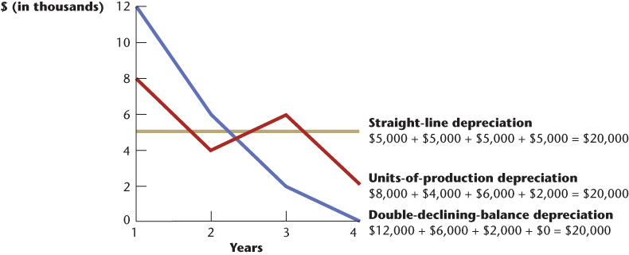
Depreciation Expense Comparisons
Notes:
8-<number>

Slide 15
3 Depreciation Methods
Straight-line
Asset cost – Residual Value OR Depreciable cost
Service Life Service life

Slide 16
3 Depreciation Methods
Double-Declining Balance =
Beg. Book Value x DDB rate = depreciation expense
(NOTE: Be careful at the end of the service years – don’t depreciate the residual value)
This is an accelerated method (higher depreciation expense taken in earlier years); yet over the service life the same total depreciation expense is taken as Straight-line

Slide 17
3 Depreciation Methods
3. Units of Production
depreciation rate = depreciable cost
total units expected to be produced
Depreciable rate x activity used = Depreciation Expense

Slide 18
Asset Dispositions – Gain/Loss
Jan. 1, 2015, Little King purchased a new delivery truck for the cost of the new truck, $45,000, Estimated residual value $5,000, Estimated service life 5 years. Little King uses SL depreciation method. The truck was sold Dec 31, 2018 for $12,000.
What is the gain/loss?

Slide 19
Asset Dispositions
($45,000-$5,000)/5 years x 4 years = 32,000
in accumulated depreciation
$45,000-$32,000 = $13,000BV
- $12,000 sale
= $1000 loss

Slide 20

Revision of Estimates
When revisions are needed:
Determine the remaining annual Book Value
Then….Stop, drop, and roll forward
With new estimates
E6-14

Slide 21
Long Term Assets
Intangible Assets
With Identifiable useful lives (copyrights, patents (20 years legal life)…amortize cost over useful life) and add any costs to successful defend to the corresponding asset account
With Indefinite useful lives (trademarks, renewable franchises, and goodwill…check for impairment of value only)

Slide 22
Ratios – on the exam
Asset Turnover = Net Sales/ Average total assets
Profit Margin = Net income/Net Sales
Return on Assets = Net income/Average Total assets
Or Profit Margin x Asset Turnover

Slide 23
Video Problems
I do: Chapter 7 P4, P2
You do: Chapter 7 P1, P5, and P6
Homework – Chapter 7 Due 3/25
Exam 2 Due 3/28 (week after Spring Break)
EXIT TICKETS DUE AT END OF EACH CLASS

